Slide 1

Information Disorder
Media Literacy introduction - lesson 2

Slide 2

Fake news?
The term ‘Fake news’ is the one most commonly used for news that is either deliberately or accidentally untrue. UNESCO (United Nations Educational, Scientific and Cultural Organisation), though, advise in their handbook for journalists that:
the phrase is inherently vulnerable to being politicised and deployed as weapon against the news industry, as a way of reporting that in power do not like. Instead it is recommended to use the terms misinformation and disinformation.
What does this clip tell us about why UNESCO are worried about using the term Fake news? How far do you agree with Donald Trump’s argument?

Slide 3

Information Disorder
A number of organisations, including UNESCO, advise the term ‘Information Disorder’ for all forms false and inaccurate online news. Such information is in contrast to verifiable information that is produced in the public interest

Slide 4
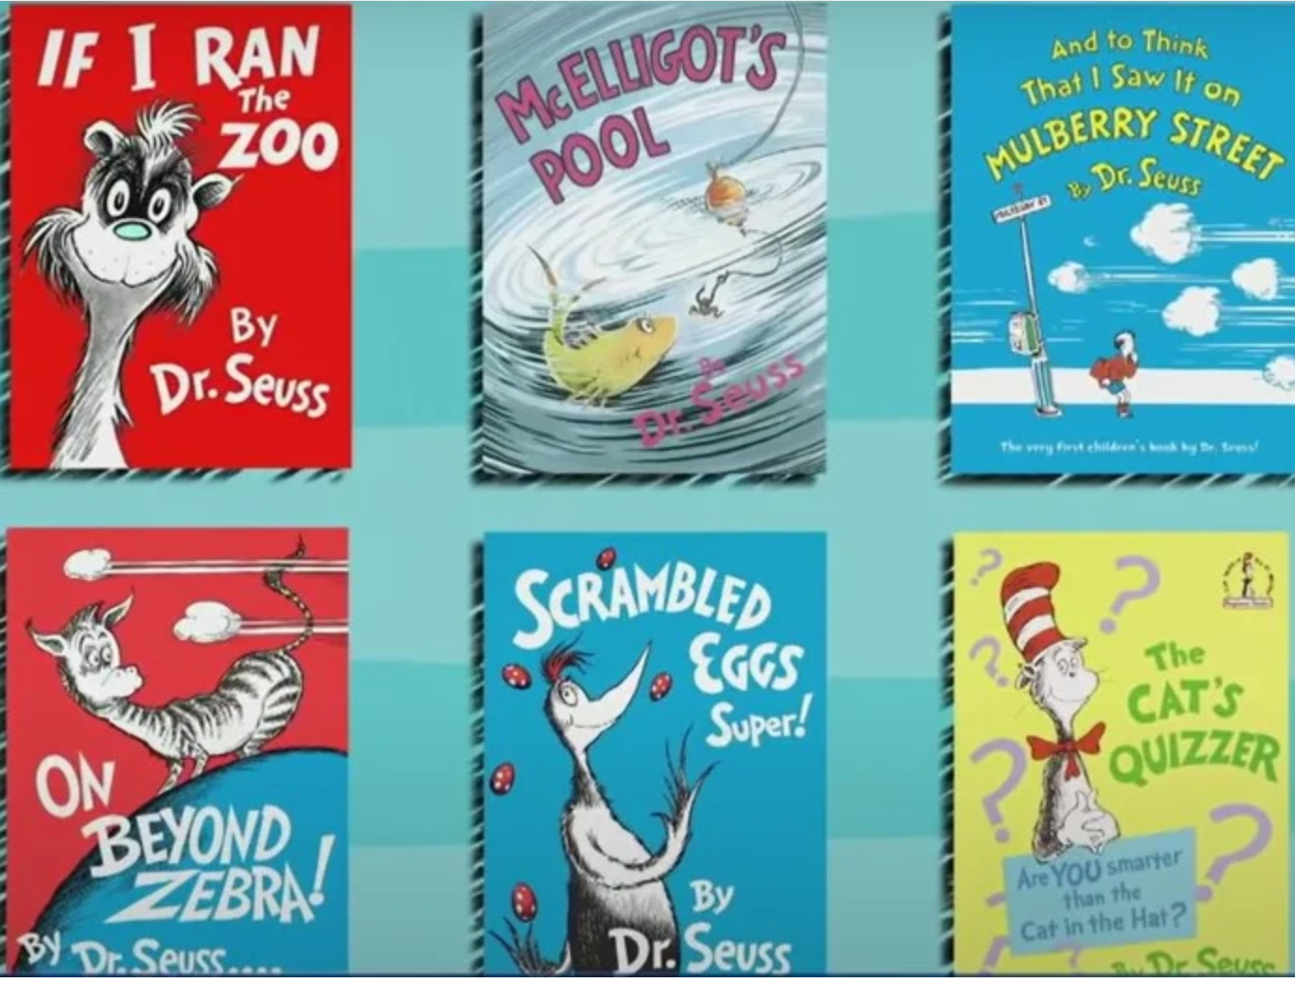
What kind of information disorder is going on here?
This is a more balanced version of events.
This is Misinformation – information that is not true, but can actually be believed to be true by the person who is disseminating it
Misinformation can be driven by a desire to establish loyalty or belonging
to a particular group or ideology by reinforcing their ideas yourself. Often
Those spreading misinformation are conspiracy theorists who genuinely believe what they are claiming.

Slide 5
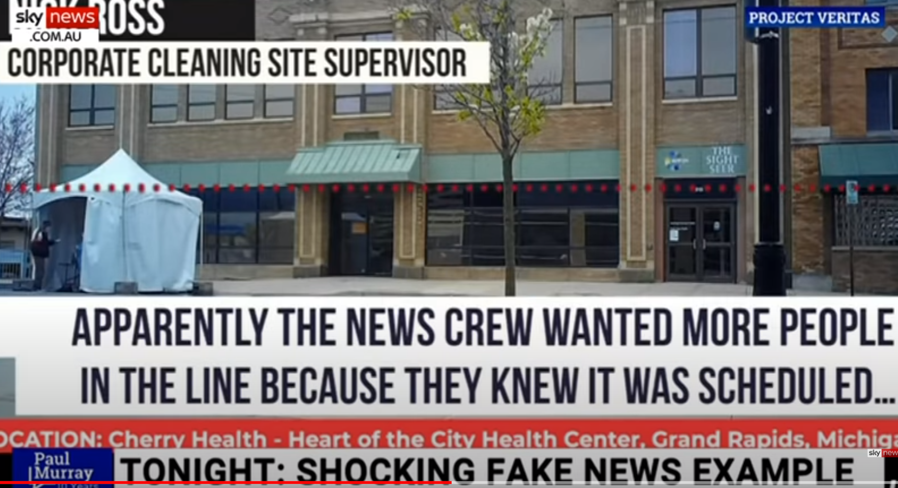
What kind of information disorder is going on here?
This is Disinformation – information that is not true, and that the person who is disseminating it knows to be false.
Disinformation is driven by the ambition of a person or organisation to either gain influence, cause troube or make money. Look at this famous example of people in Macedonia making lots of money from disinformation.

Slide 6
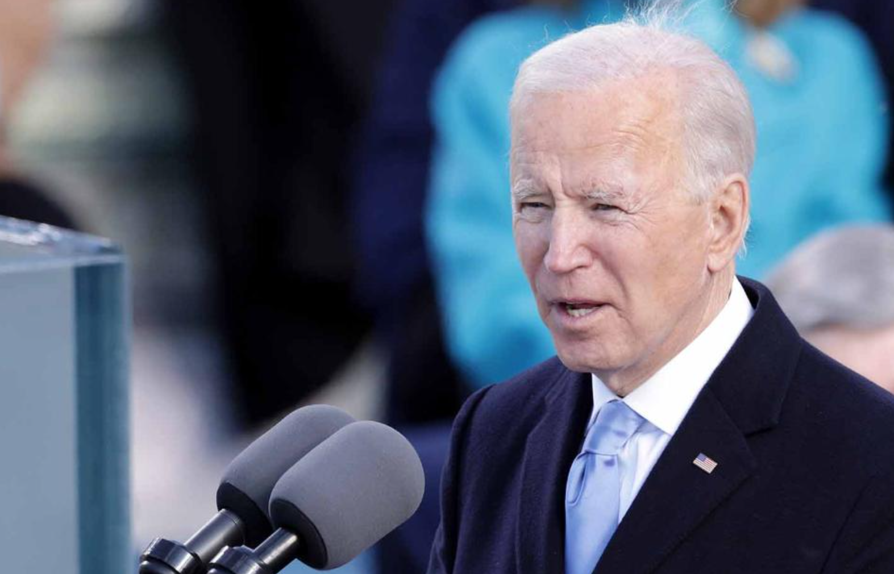
What kind of information disorder is going on here?
This is Malinformation – information that is at least based on reality but is reported in order to be damaging to a person or organisation.

Slide 7
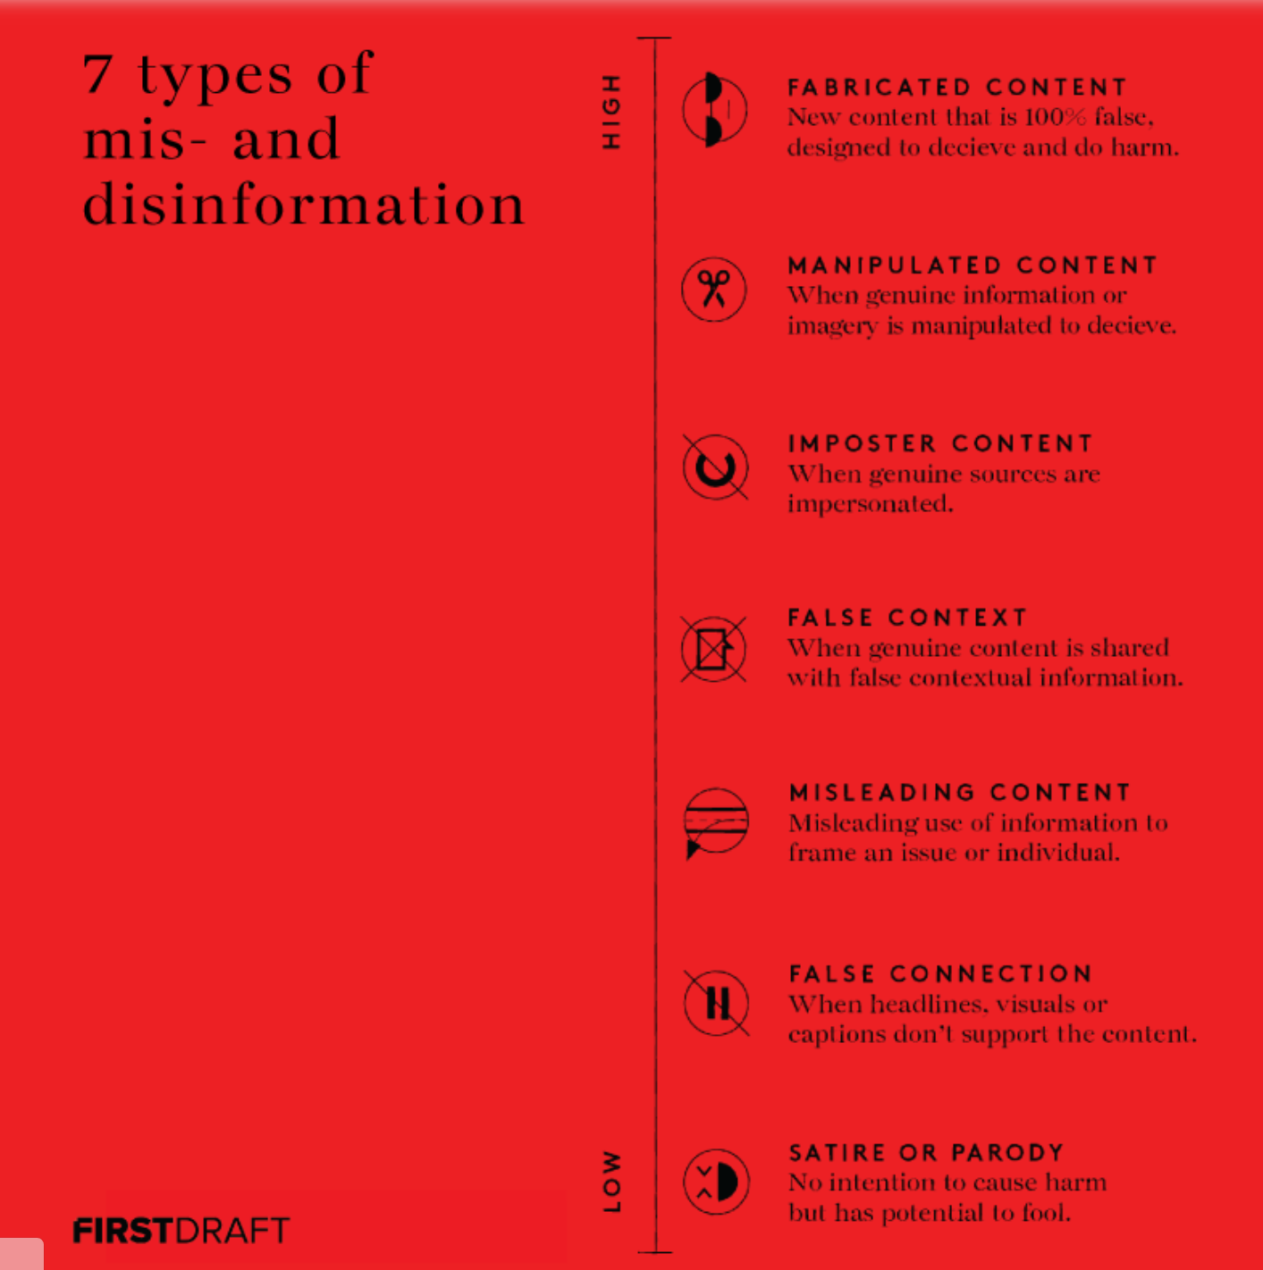
This is a list of many of the different types of information disorder. Using your general knowledge and phones/laptops see if you can find an example of each of these in your groups
https://firstdraftnews.org/latest/information-disorder-the-techniques-we-saw-in-2016-have-evolved/

Slide 8
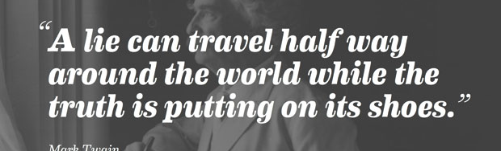
Why is Information Disorder so successful? Discuss in your groups to think of possible answers
A very convincing explanation of the success of Information Disorder in all its forms can be seen in cognitive bias which focusses on the fact that humans tend to make decisions and judgements based on emotion rather than fact rather more than they would like to think!

